Slide 1
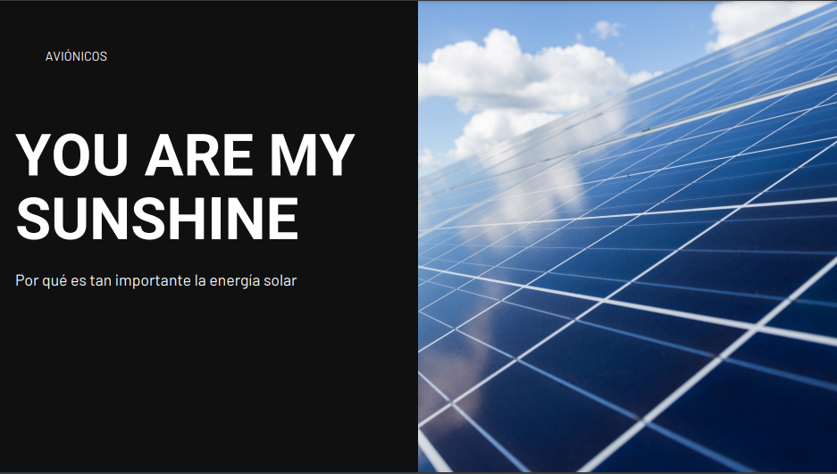
On why solar energy is so important

Slide 2
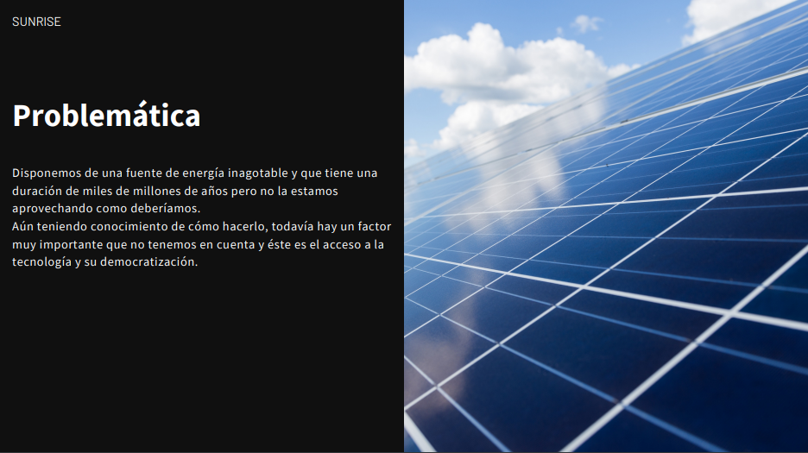
The issue
We have an unlimited source of power which has thousands of years of lifetime, yet we are not taking advantage of it as we should.
Even having the knowledge on how to do it, there's still an important factor we don't have in consideration and that is the access to technology and it's democratization.

Slide 3
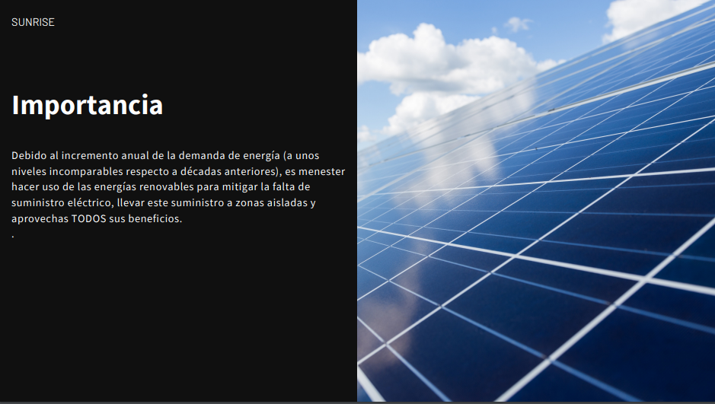
Importance
Due to the yearly increase on power demand (with uncomparable levels respect to prior decades), it's needed to make use of renewable energys to mitigate the lack of power supply, take it to isolated zones and take advantage of all their benefits

Slide 4
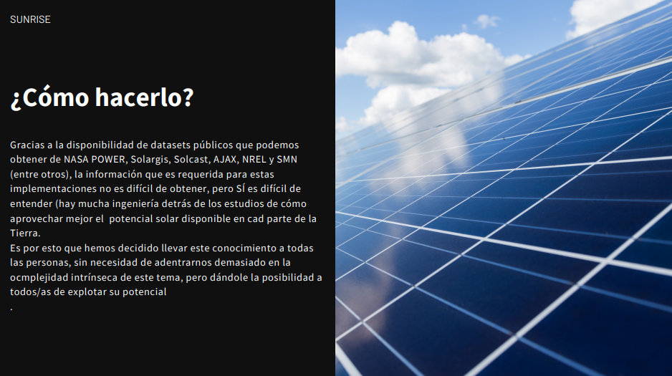
How to do it?
Thanks to the availability of public datasets that we can get from NASA POWER, Solargis, Solcast, AJAX, NREL and SMN (among others), the information required for these implementations it's not hard to get, but it IS hard to understand (There's a lot of engineering behind the studies of how to get the most out of the sun available on each part of the Earth).
That's why we have decided to take this knowledge to all the people, without the need to get into the intrinsic complexity of the subject

Slide 5
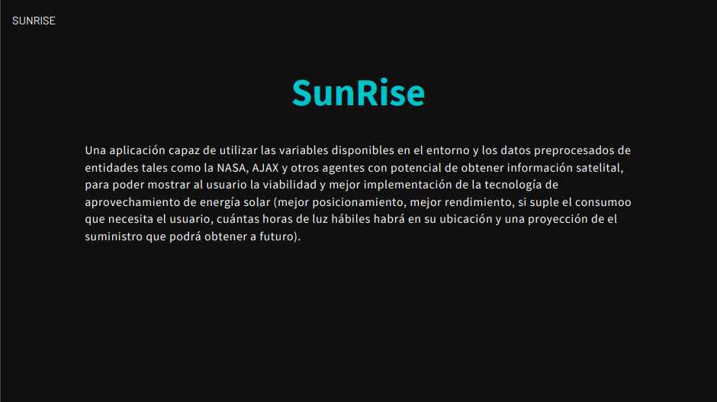
An app capable of utilizing the available variables of the environment and pre processed data from entities such as NASA, AJAX and other agents with satellite information access, to show the user the viability, and the best implementation of the solar power technology (better positioning, better performance, if it satisfies the user's energy consumption, how much sun time will be available at the location and a projection of future energy supply).

Slide 6
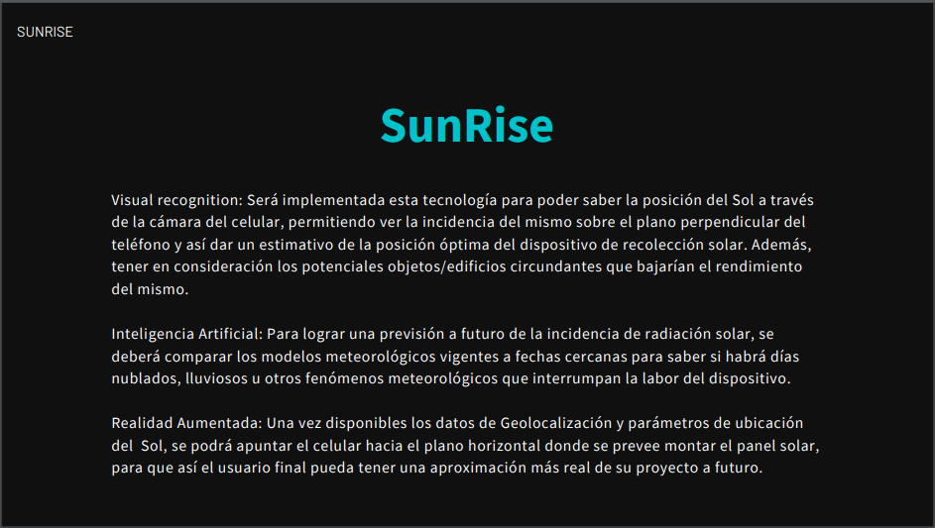
Visual recognition: This technology will be implemented to be able to know the Sun's position through the cell phone camera, allowing to see the incidence of it above the perpendicular plane of the cell phone, and thus give an estimate of the optimal position for the solar collection device. Besides, taking into consideration potential objects/buildings from the surroundings that could lower it's performance.
Artificial intelligence: To achieve to-future forecast of solar radiation incidence, current meteorological models shall be compared to know if there will be cloudy or rainy days, or other Meteorological phenomena that that interrupt the work of the device.
Augmented reality: Once the Geolocalization and Sun location parameters are available, the cellphone will be pointed to the horizontal plane where the solar panel is to be mounted, so that the user could get a more real approximation to the future.

Slide 7
